Slide 1
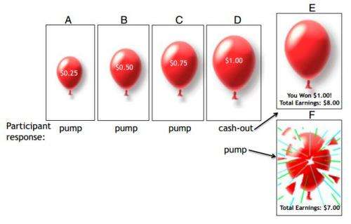
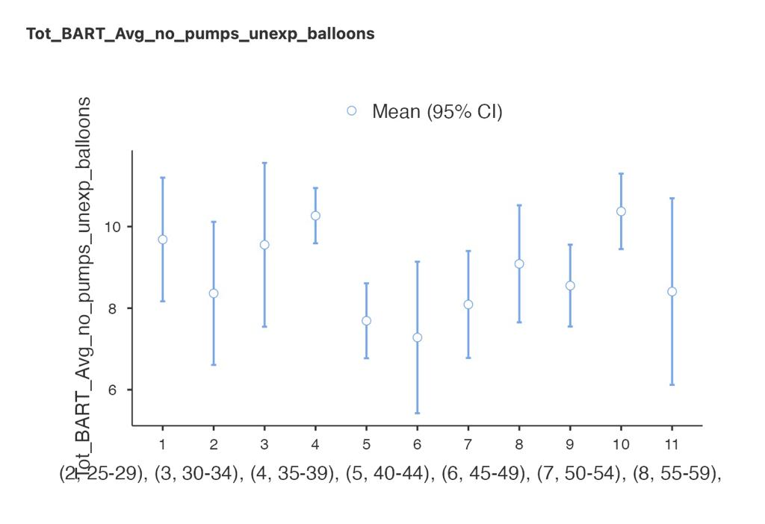
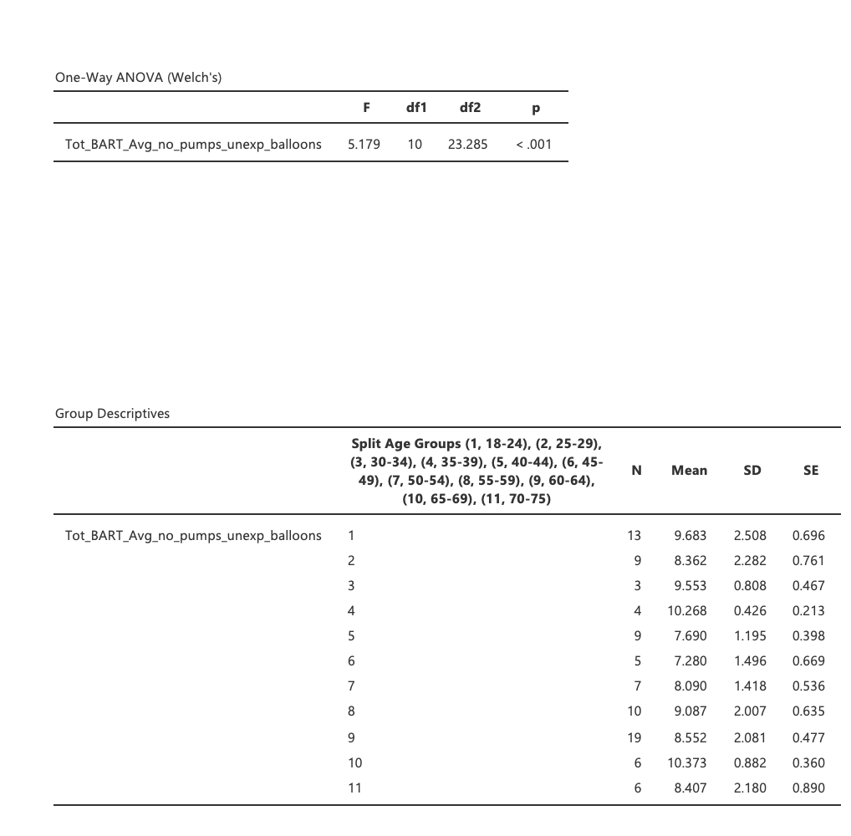
MSc in Computational Cognitive Neuroscience
Exploring the Association Between Risk-Taking Behaviour, Impulsivity, Learning Strategies, and Age Using the BART
Researcher: Lina Charafeddine Supervisor: Dr. Marinella Cappelletti
Introduction
Performance on risky decisions changes as a function of age, where middle-aged adults have a preference for net outcome with learning (Beitz et al, 2014)
Research Question(s)
Main: Is risk decision-making modulated by age and what are its physiological correlates?
Secondary:
Are there correlations between the self reported impulsivity, learning strategy, and DASS-21 scale?
Are there correlations between M1 excitability/inhibition and performance on the BART?
Hypothesis
There will be a direct effect of age on the performance of BART.
Methods
Balloon Analogue Risk Task (Lejuez et al, 2002)
Barratt Impulsiveness Scale (BIS – 11) (Patton et al., 1995)
Depression and Anxiety Stress Scale -21 (DASS21-Henry et al, 2005)
Preliminary results (previous data)
Using one-way anova
Independent Variable – age group
Dependent Variable – total average number of pumps on unexploded balloons

