Slide 1
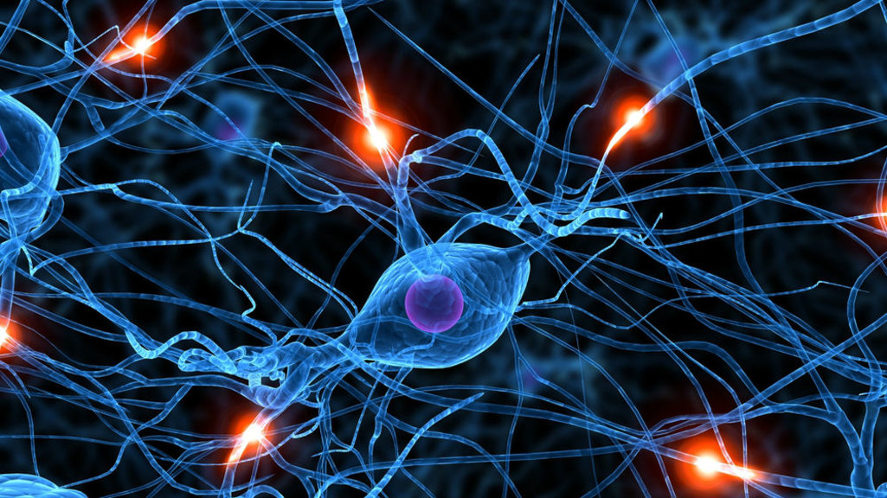

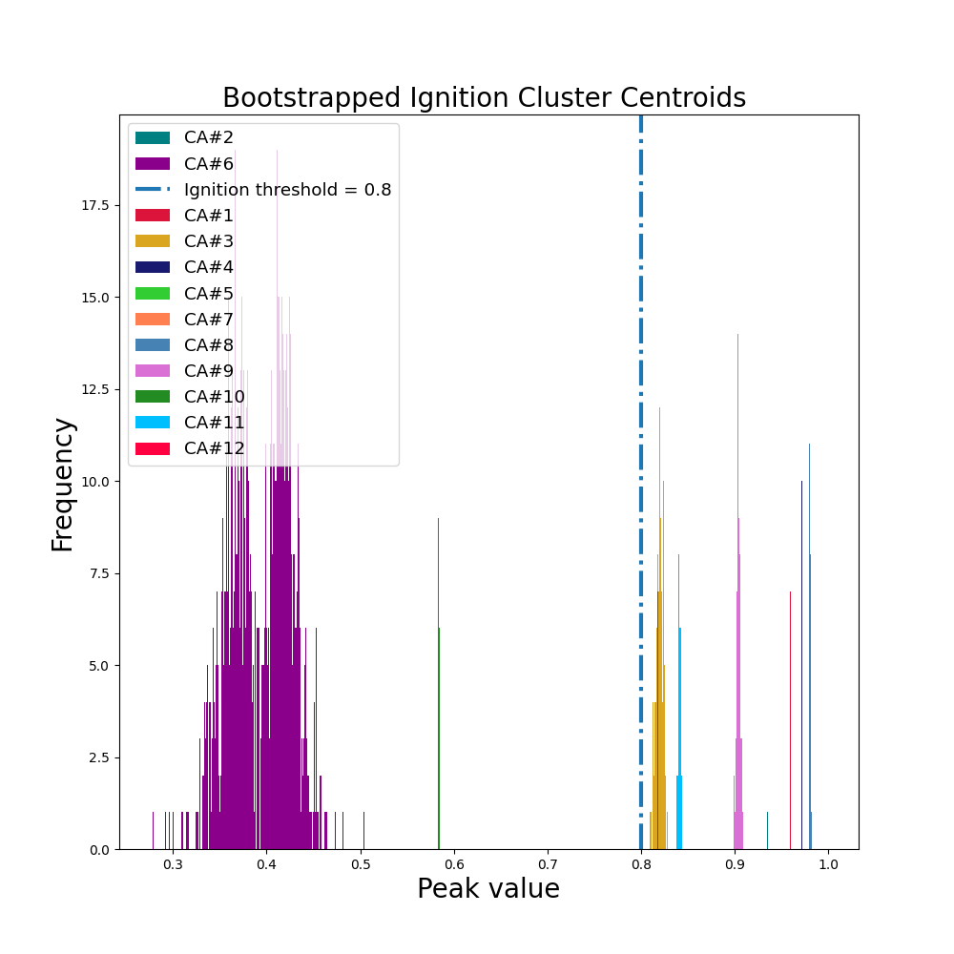
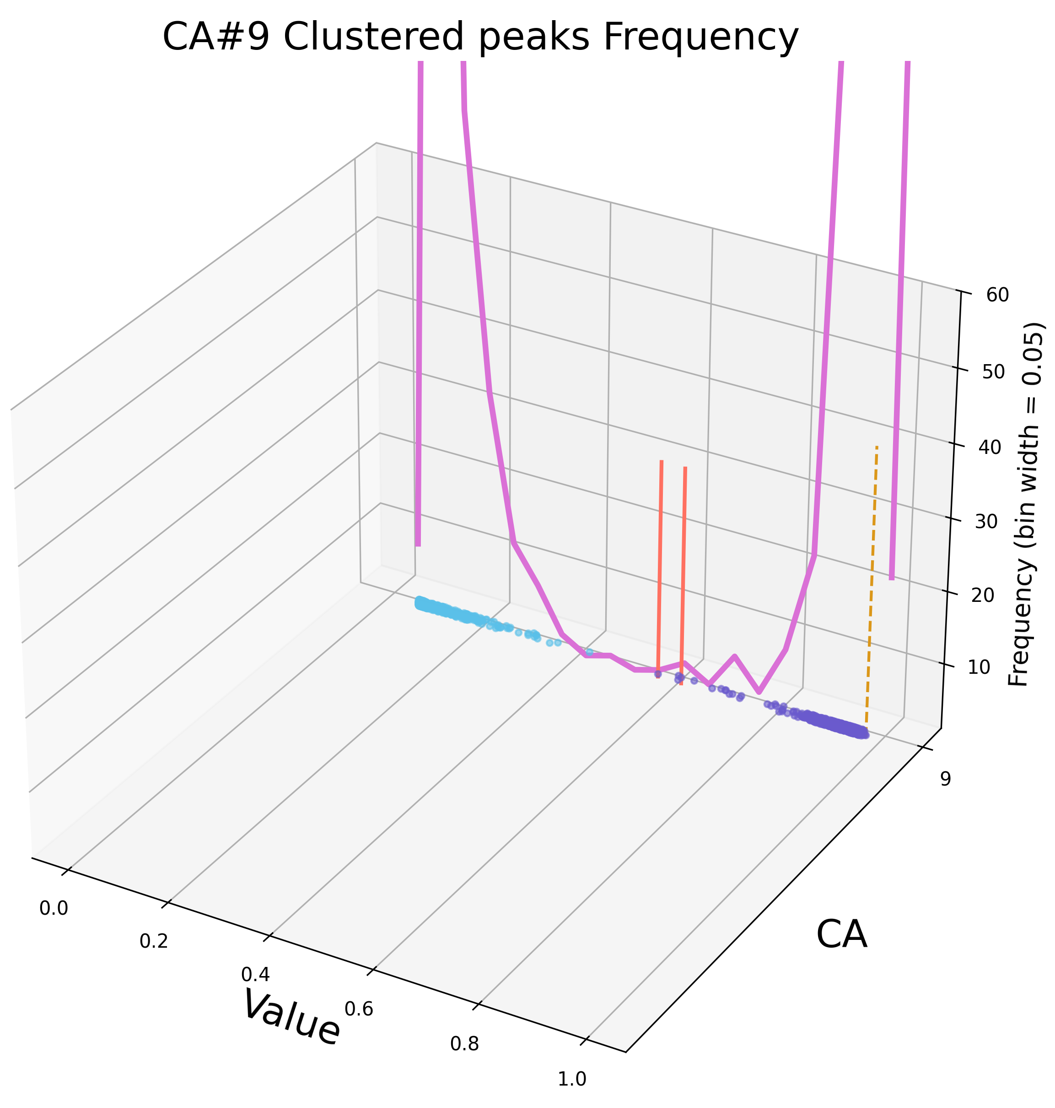
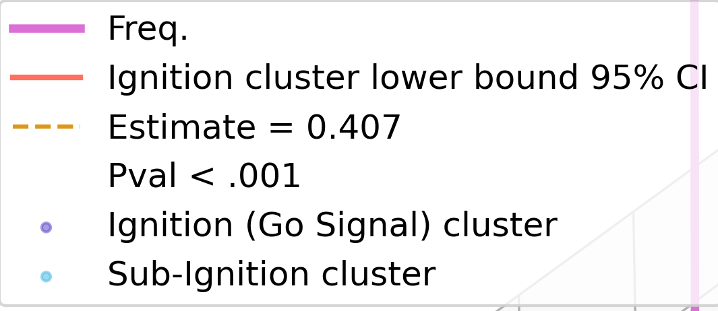
MSc : Computational
Cognitive Neuroscience
Volitional Action and the 'Point of no Return' : building on a computational model of spontaneous action initiation
Felix Noble, Nick Griffin (Supervisor), Max Garagnani (Supervisor)
Spontaneous actions
Volitional actions are preceded by a decision to act. Decisions of what to do (Goal), how precisely act (Action), and when to behind the action (Time) are behaviorally disassociated.
\\
GO
STOP
0
\\
Time (ms)
The 'Point of no Return'
After a decision of when to act has been made, the Go (endogenous) signal (premotor --> motor neurons) can be impeded by a Stop (exogenous) signal (Schultze, Kraft et al., 2016).
>= 150
t - 200
<= 30*10³
Action onset
t
Action onset
Methods:
Results:
Cell Assembly (CA) activity over time
Analysis:
Ignition threshold : (CA 2,CA 6 dropped)
Differentiating sub-ignition from ignition
Rate coded cortical simulations
A neurobiologically constrained model of 6 cortical areas (Garagnani & Pulvermüller, 2013) has been shown to model "Readiness Potentials" preceding action initiation and replicates the observed wait time distribution (Griffin et al., submitted; Schurger et al., 2012).
Constraints:
Excitatory / Inhibitory cortical layers
Sparse, random, jumping projections
Weight Training: LTP / LTD => 12 Cell Assemblies (CA)
Training:
12 Motor-Sensory pairs presented to areas 1 & 6 in a non-repeating, randomised order
2.4 *10⁶ training steps
Hypotheses:
Proportional CA (normalised by CA size) activity forms peaks, expected to cluster (KMeans) around baseline, sub-ignition, and ignition foci.
The 'point of no return' would, if present, be above the highest possible sub-ignition peak.
Bootstrapping:
N = 1000
Peaks data resampled and re-clustered
Cluster lower bound is the smallest peak value in each cluster
Estimating the 'Point of no Return'
Estimations ranged from 0.101 to 0.465, CA's 1, 3, and, 9 estimated > 0.4.
CA 8 failed to reach significance
Next Steps:
Is the 'Point of no return' statistically different across CA's?
Garagnani, M. and Pulvermüller, F. (2013) “Neuronal Correlates of Decisions to Speak and Act" ; Griffin, N., Garagnani, M. and, Schurger, A. (submitted) ; Schurger, A. Sitt, J., Dehaaene, S. (2012) “An Accumulator Model for Spontaneous Neural Activity prior to Self-Initiated Movement.”
ferences, acknowledgements, third party logos and your contact details, if required.

