Slide 1
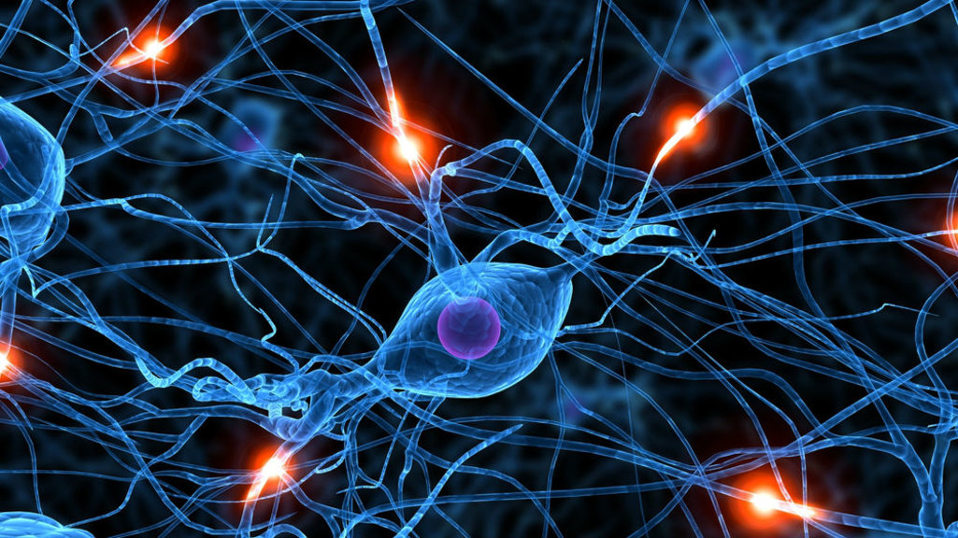

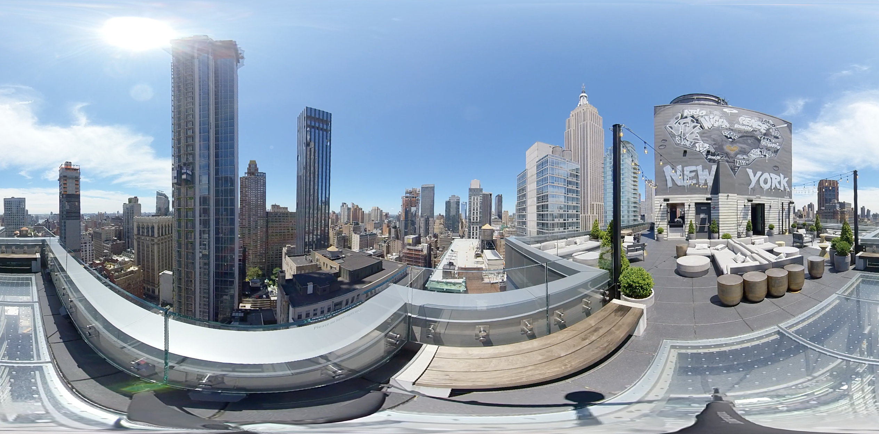
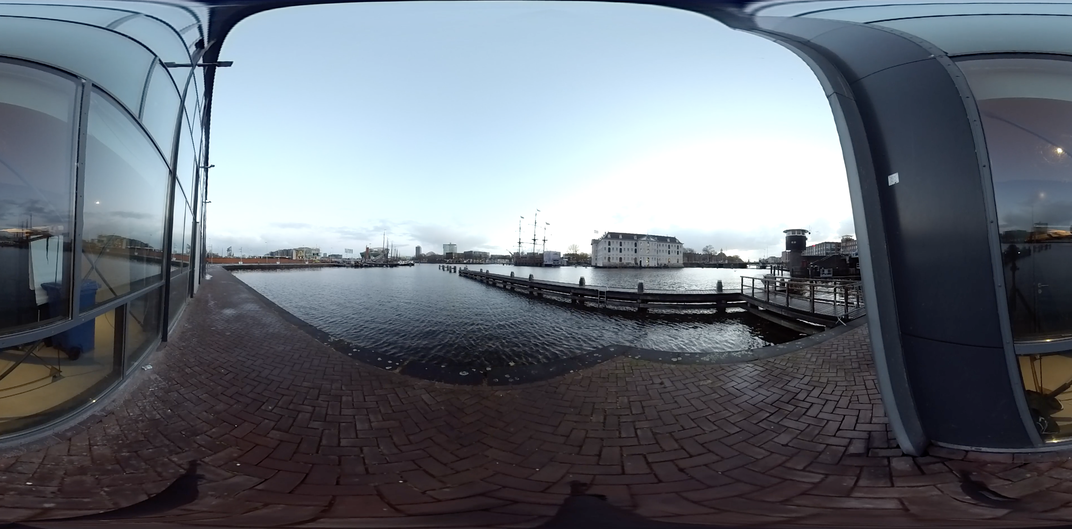
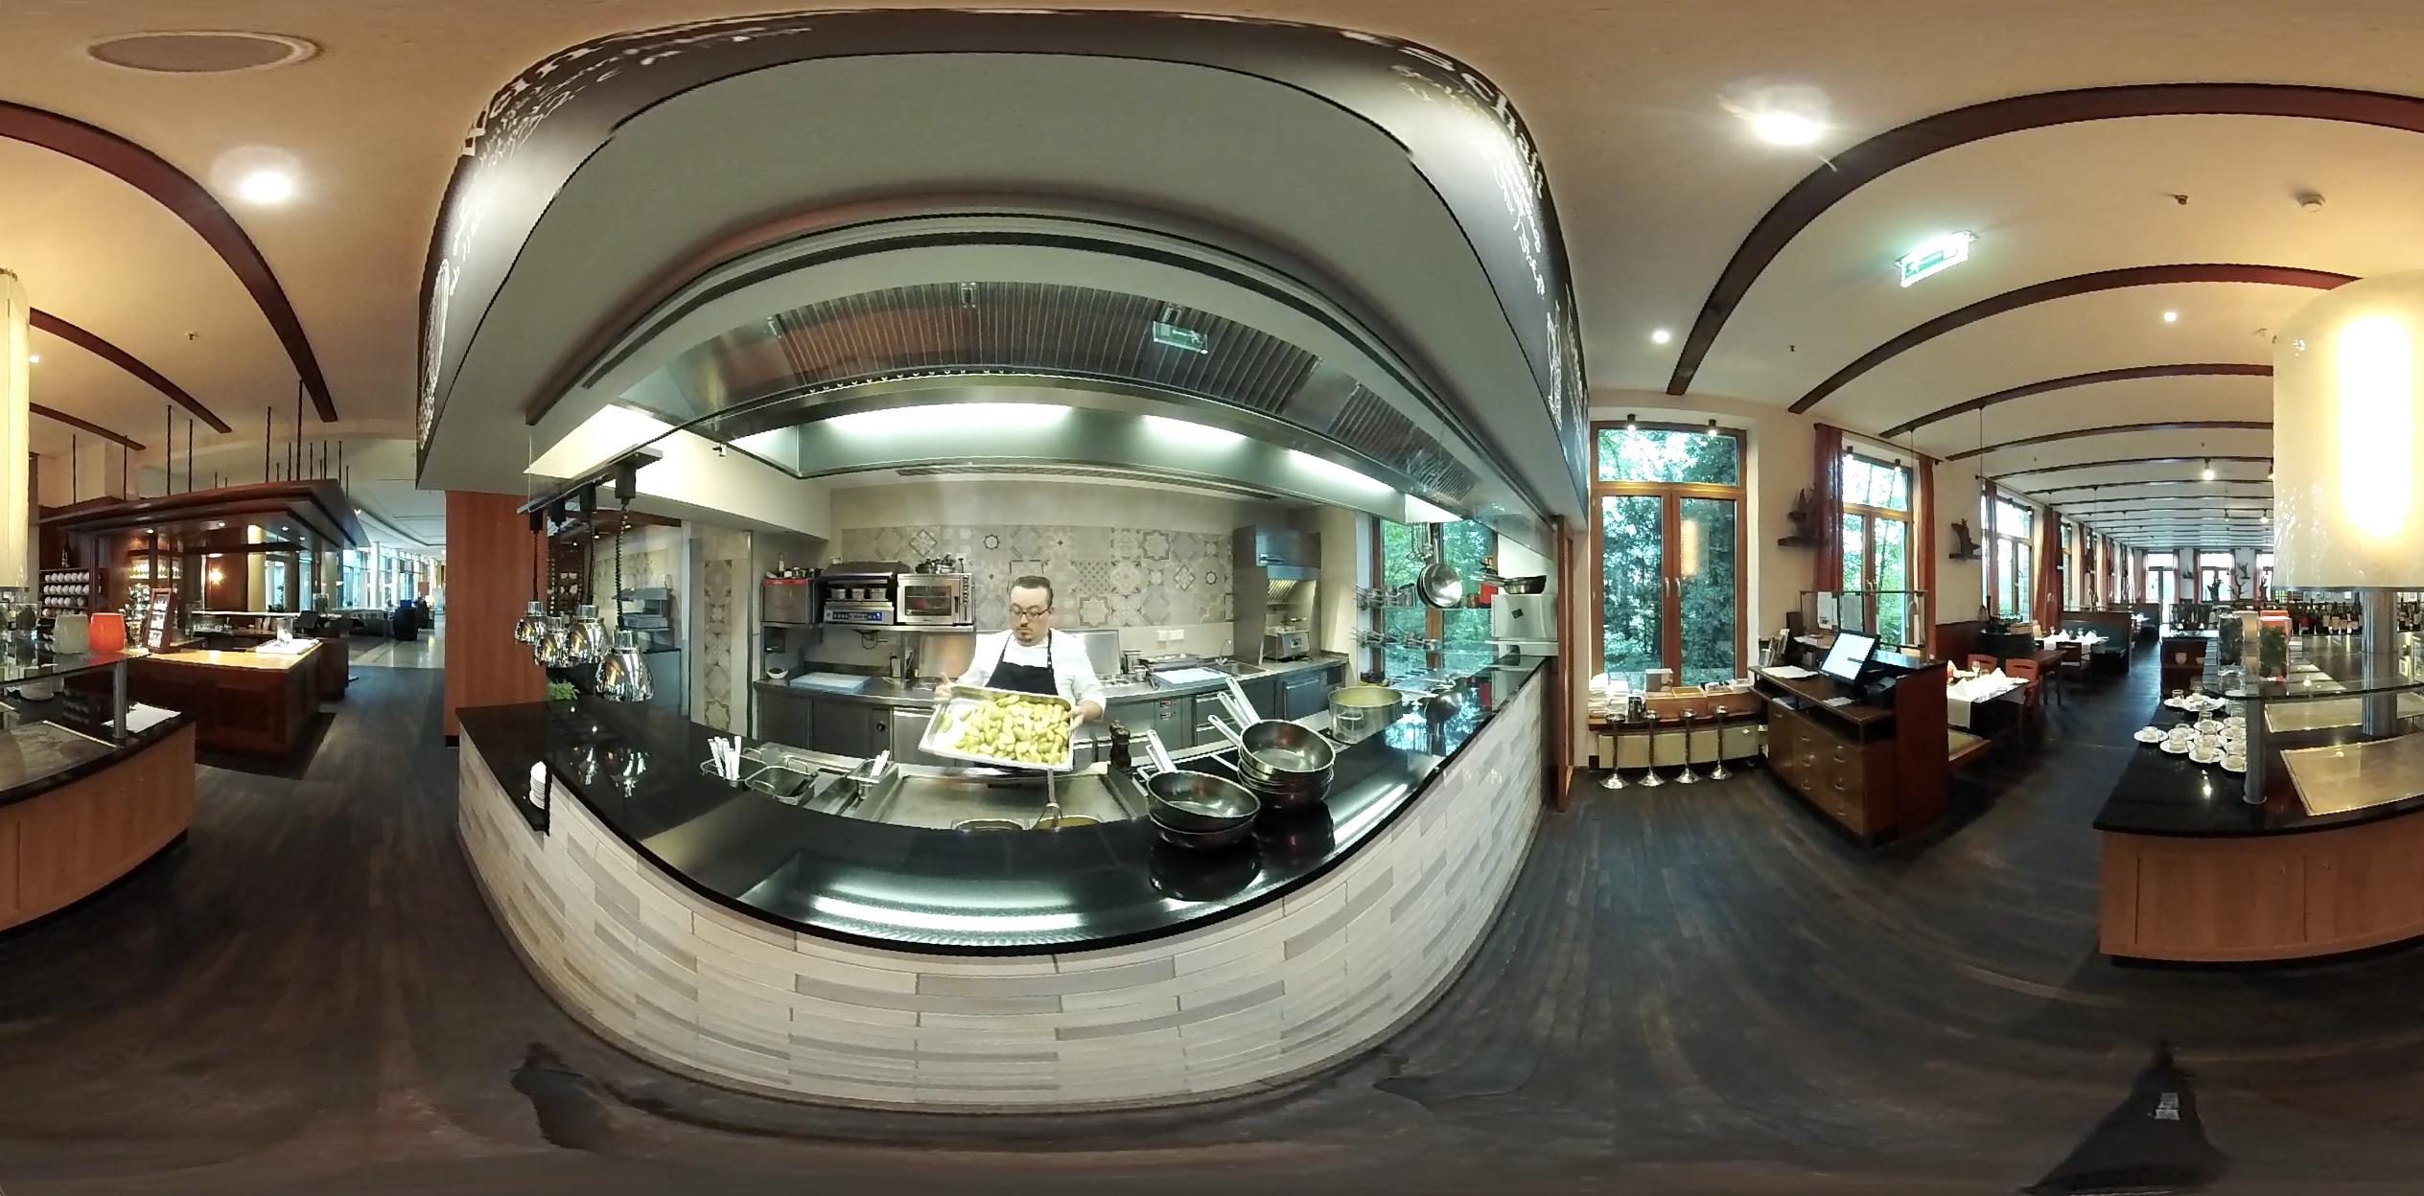
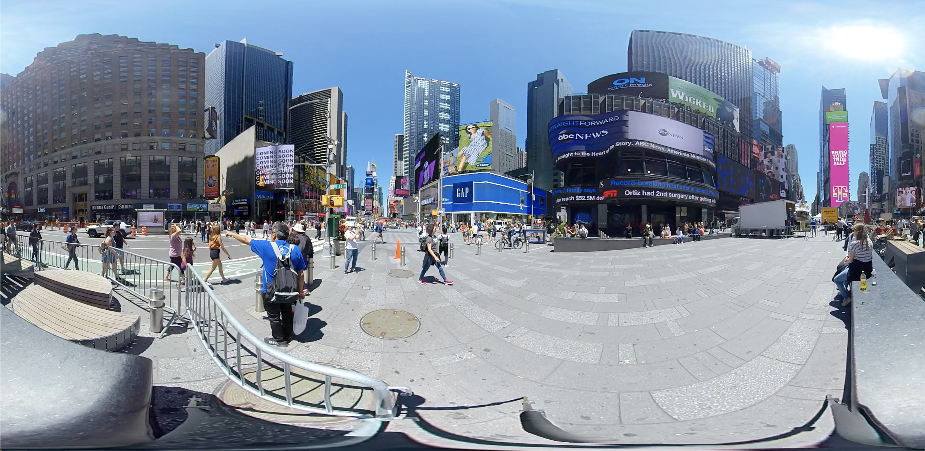
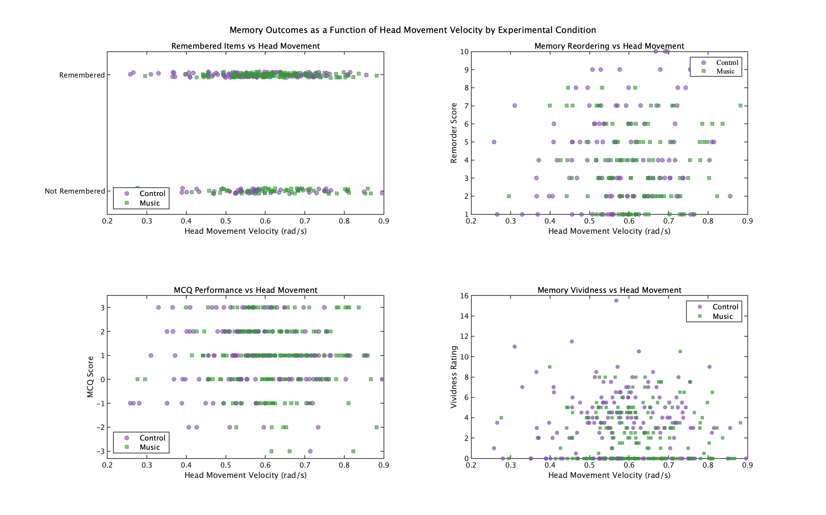
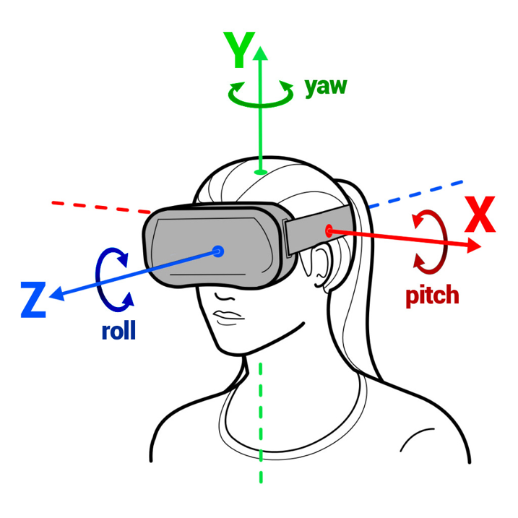
MSc in Computational Cognitive Neuroscience
Exploring Music-Movement-Memory Relationships in Virtual Reality Environments. Marian Aguiló-Mayans - Supervisors: Safiyyah Nawaz and Diana Omigie
Introduction
Listening to music often leads to movement, particularly head movements (González Sánchez et al., 2020; Keller & Rieger, 2009). A study on music-elicited head movements suggests to explore these movements in naturalistic environments (González Sánchez et al., 2020). Timbral musical features influence head movement patterns during listening (Burger et al., 2013), and embodied cognition theories link movement to memory formation (Goldin-Meadow & Beilock, 2010). However, gaps remain regarding music's influence on head movement during naturalistic, non-music-focused activities and its memory implications.
Research Questions & Objectives: How does background music influence head movement velocity in naturalistic Virtual Reality (VR) environments? Does head movement speed predict memory outcomes? What role does musical features play in the music-movement-memory relationship?
Aims & Hypotheses : (1) Music's influence on head movement velocity in naturalistic VR. (2) Whether head movement speed predicts memory performance in the music condition. (3) Music features will mediate the music-movement-memory relationship.
Methods
Design
Quasi-experimental between-subjects design. DVs: Head movement velocity (GVM); Memory outcomes (recognition, recall order, MCQ scores, vividness)
IVs: Group (Music/Control); Musical features (tempo, key clarity, pulse clarity, brightness, roughness)
Participants
42 participants completed the study (22 control, 20 music condition). The control group had a mean age of 21.0 (SD = 4.3) and with one male (4.5%), 19 females (86.4%), and two non-binary participants (9.1%). The music group had a mean age of 23.1 (SD = 3.2) including 1 male (5.0%) and 19 females (95.0%).
Procedure
Participants viewed 10
one-minute naturalistic VR
Videos with a headset (see
Figure 1), each followed by
a narrative simulating a trip.
Eight trials with music and
two silent. Control
participants experienced
all videos without music.
One week later,
participants completed a
remote memory questionnaire.
Preliminary Results
The first hypothesis was accepted. Music showed significantly higher GVM than controls, β = 0.042, SE = 0.021, t(334) = 2.06, p = .040, 95% CI [0.002, 0.083], with a small effect size (standardized β = 0.42). See Figure 3.
The second hypothesis was rejected. The four linear mixed-effects models revealed no significant effects of GVM or music condition on memory performance (all p > .05). See Figure 4.
Figure 3
GVM by experimental condition.
Figure 1
Still image of videos shown in the trials.
Figure 4
Memory Outcomes as a Function of Head Movement Velocity by Condition.
Four LMEMs assessed interactions between GVM and group (music vs. control) on:
Recall accuracy (Remembered), Temporal order of recall (remorder),Memory multiple choice questionnaire (MCQ_score) and Subjective vividness (Coded_vividness).
Mediation analysis tested whether acoustic features (extracted via the MIR Toolbox) including tempo, key clarity, pulse clarity, brightness, and roughness, indirectly influenced memory outcomes through their effects on head movement (GVM).
Analysis
Linear mixed-effects model (LMEMs) examined the effects of music on head movement speed (quantified via Gyroscope Vector Magnitude, GVM = ||ω̅||₂ = √(ωₓ² + ωᵧ² + ωz²) and memory performance. See Figure 2 for axis representation.
Figure 2
X, Y, Z Axis Representation
Conclusion
Findings are in line with previous studies where music elicited head movements are different to non-music (González Sánchez et al., 2020). This extends previous findings to naturalistic VR environments.
Goldin-Meadow, S., & Beilock, S. L. (2010). Action’s influence on thought: The case of gesture. Perspectives on psychological science, 5(6), 664-674.
González Sánchez, V., Żelechowska, A., & Jensenius, A. R. (2020). Analysis of the movement-inducing effects of music through the fractality of head sway during standstill. Journal of motor behavior, 52(6), 734-749.
Keller, P. E., & Rieger, M. (2009). Musical movement and synchronization. Music Perception, 26(5), 397-400.
Burger, B., Thompson, M. R., Luck, G., Saarikallio, S., & Toiviainen, P. (2013). Influences of rhythm-and timbre-related musical features on characteristics of music-induced movement. Frontiers in psychology, 4, 183. Wilson, M. (2002). Six views of embodied cognition. Psychonomic bulletin & review, 9, 625-636.
Notes:
Goldin-Meadow, S., & Beilock, S. L. (2010). Action’s influence on thought: The case of gesture. Perspectives on psychological science, 5(6), 664-674.
González Sánchez, V., Żelechowska, A., & Jensenius, A. R. (2020). Analysis of the movement-inducing effects of music through the fractality of head sway during standstill. Journal of motor behavior, 52(6), 734-749.
Keller, P. E., & Rieger, M. (2009). Musical movement and synchronization. Music Perception, 26(5), 397-400.
Burger, B., Thompson, M. R., Luck, G., Saarikallio, S., & Toiviainen, P. (2013). Influences of rhythm-and timbre-related musical features on characteristics of music-induced movement. Frontiers in psychology, 4, 183.
Wilson, M. (2002). Six views of embodied cognition. Psychonomic bulletin & review, 9, 625-636.

