Slide 1
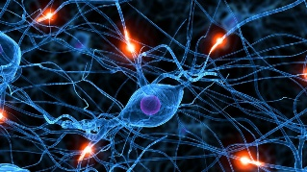

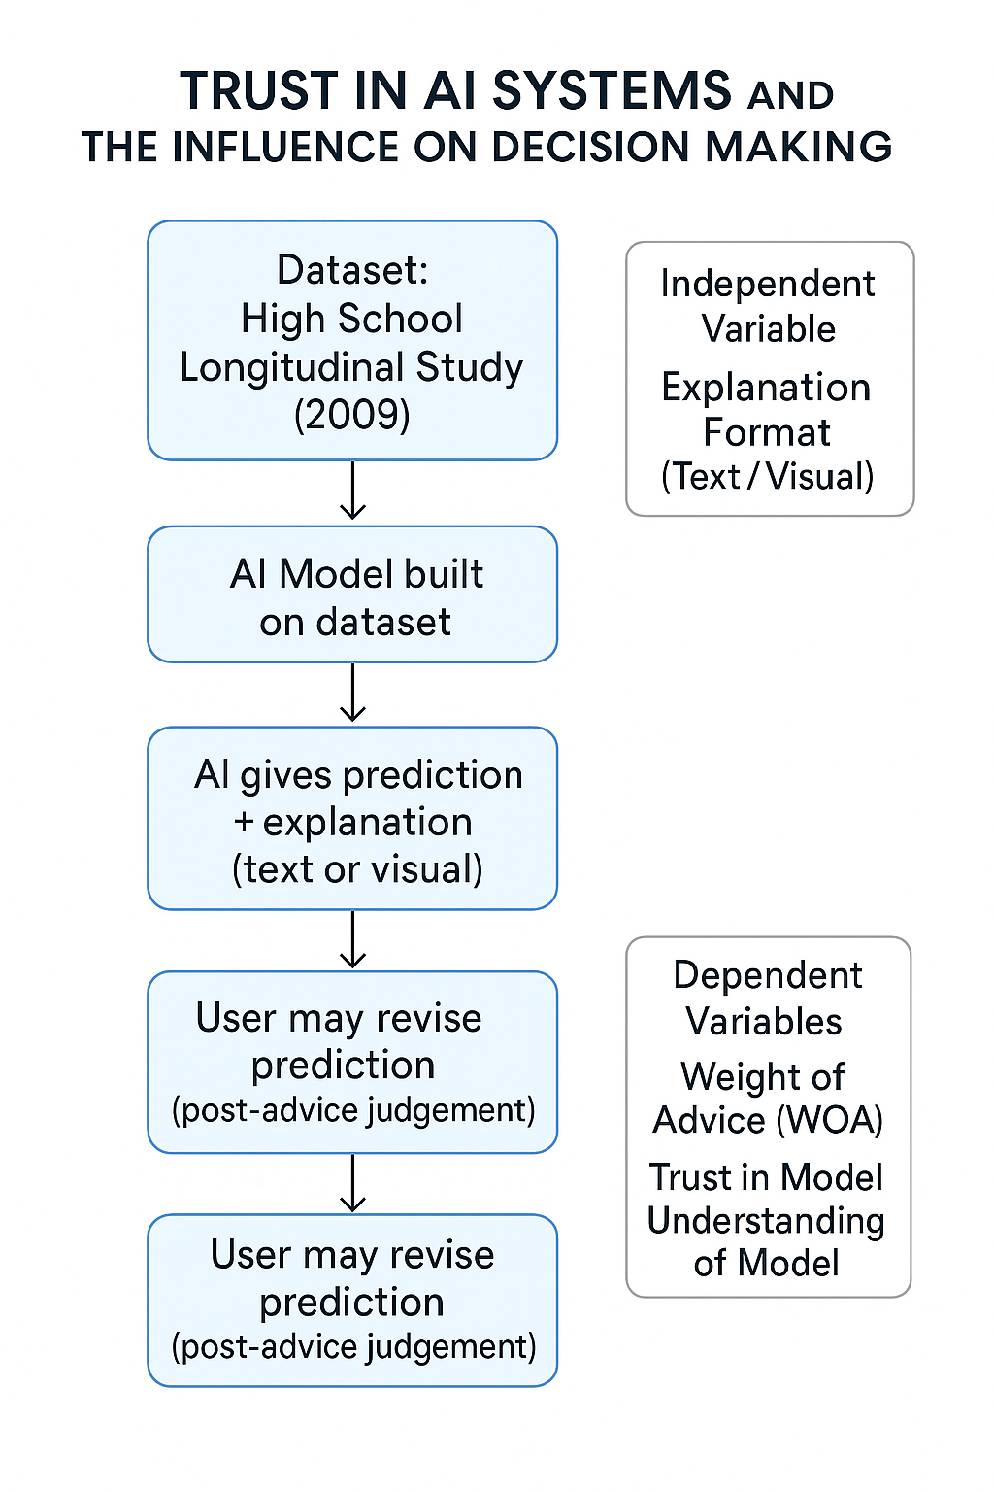
MSc in Computational
Cognitive Neuroscience
Trust in AI systems and the influence of AI on decision making
Student: Talha Ahmed Malik Supervisor: Dr. Bence Palfi
Background
The main problem with AI models being deployed is the lack of trust around these models from people. Although various strides have been made to explain the black-box surrounding these AI models but still users are hesitant to trust these models and therefore rely more on their hindsight rather than the output generated by AI models.
Our work will build upon the work already done by Dietvorst et al. where in their paper they talk about how people will trust and use an Imperfect algorithm over their own choice in forecasting situations. [3] (Dietvorst, et al., 2018).
Procedure
Building upon an openly available dataset this project involves developing a predictive AI model alongside surrogate models to provide interpretable explanations for these predictions. These models will be tested through hypothetical scenarios presented to general public (e.g., simulating the interaction with an AI tool), allowing us to evaluate the impact of different explanation types on users' understanding, trust and behavior.
Expected Results
An AI Predictive model will be built using python. The AI model will be trained on the public dataset outlined above and by splitting the data into two training and testing the accuracy of the model will be recorded. We will also see test the model against some of the responses of the users and see given in certain scenarios how does the model fare to the users. Statistical regression techniques will also be performed to see how different models perform and how well a model is normalized to optimize output. Then the model will be will be presented in front of the users. We will provide different explanations for different scenarios and see if the depth of explanations has any impact on the opinion of the people. We also have grand truth scores as well in the database so we can measure how much people use advice as well as how much their judgements improve/ worsen in case of advice taking from the AI system and the explanations of the advice given the system.
Introduction
We use the “High School Longitudinal study of 2009” [2] (Statistics), n.d.) dataset to devise an AI model. This dataset consists of a Longitudinal study of more than 21000 9th graders. Their performance was monitored throughout high-school, post-secondary education, the workforce and beyond. The main purpose of this was to decide what, why, when and how students decided to pursue. We will build upon this dataset to create an AI system as well as a series of hypothetical scenarios where our participants will be asked to make judgements without and with the advice from our AI tool. Moreover, we are interested in the role of explanations and their presentation format (text vs visual) on how much people trust and use advice from an AI tool.
Hypothesis
People who are given a simpler form of explanation that incorporates both visuals and texts to be more understanding than explanations that only provide one of the two. [4] (Rago, et al., 2024).
People will rely more on AI systems and their opinions will be more influenced by the predictions set-forth by AI systems especially in decision making subjects. [5] (Chugunova & J. Luhan, 2024)
Summary
Objectives
Does the explanation of a model have any influence on the decision making of humans?
Does the type of explanation (visual vs text) have an influence on the decision making of humans?
Design
An AI prediction model will be created in which users will be presented with different explanations for different type of questions such as high school science grades and their correlation to how further education a person gets and their success in the workforce.
User output is asked for from the user.
Then the model output and an explanation is presented to the user. Some users will be presented with text output while others are presented with a visual output.
User will be given a chance to change their output based on the model output and explanation.
By doing this we want to see the effect an explanation of a model has on the change of opinion of the user.
Chugunova, M. & J. Luhan, W., 2024. Ruled by robots: preference for algorithmic decision makers. Springer Nature.
Dietvorst, B. J., Simmons, J. P. & Massey, C., 2018. Overcoming Algorithm Aversion: People Will Use Imperfect Algorithms If They Can (Even Slightly) Modify Them. Informs.
Rago, A. et al., 2024. Exploring the Effect of Explanation Content and Format on User Comprehension and Trust.

